Slide 1
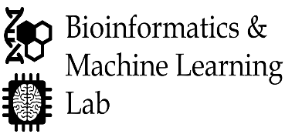
A Machine Learning Approach for Oyster Disease Prediction
Md Wasi Ul Kabir, Aasish Rijal, Thomas Soniat, Md Tamjidul Hoque
Department of Computer Science
The University of New Orleans, New Orleans, LA

Slide 2
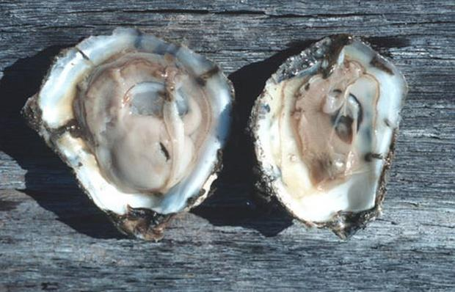
Presentation Overview
Introduction
Problem Description
Data Collection
Dataset Preprocessing
Imputation of Missing Values
Machine Learning Algorithms
Performance Measures
Feature Selection and Hyperparameter Tuning
Evaluation of Performance
Conclusions and Future Work
Image Source: https://www.oyster.umd.edu/dermo-disease-testing

Slide 3
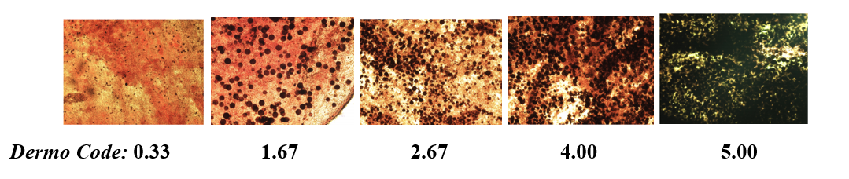
Problem Description
The parasite Perkinsus marinus (dermo) is a major cause of mortalities of oysters in the Gulf of Mexico.
The prediction of oyster disease can be used to reduce the infections.
The dermo oyster disease has been measured by disease code.
The higher the code of an oyster, the worse the oyster condition is.
Figure 1: Disease code for oysters

Slide 4
Infection Measures
Percent Infection (PI):
  Inf = (number of Infected Oysters) / (number of Oysters Tested) * 100%
Infection Intensity (II):
  Int = (Sum of Disease Codes) / (number of Infected Oysters)
Weighted Prevalence (WP):
  W.Prev = (Sum of disease codes) / (number of Oysters Tested)

Slide 5
Problem Description
The goal is to develop a machine learning model that can give us one-year forward prediction of Oyster disease.
The users can determine:
    Season
    Reef Area
    Temperature and Salinity profile from low to high

Slide 6
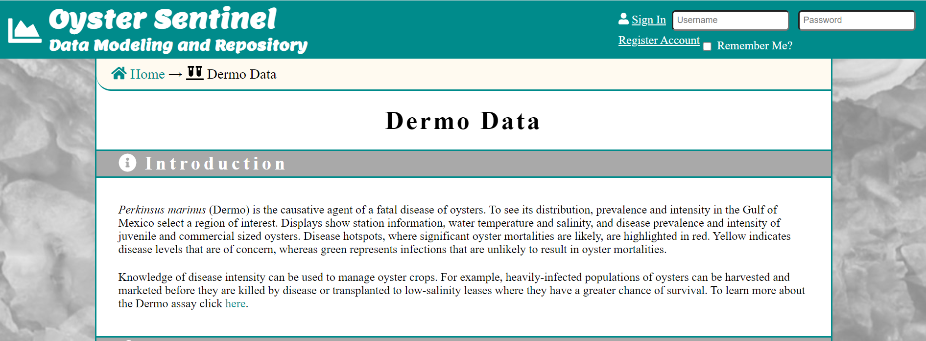
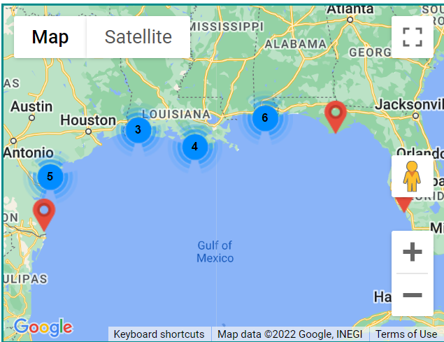
Data Collection
We collected the latest raw data from the UNO database. (https://data.oystersentinel.cs.uno.edu/dermo)
The data repository has collection date, station information, water temperature and salinity from estuaries across the Gulf.
The dataset contains 3414 samples which are collected from
January 1, 1997, to October 13, 2020
The data split into two types of Oyster:
Juvenile (< 75mm) and Adult (>= 75mm).
Image Source: https://data.oystersentinel.cs.uno.edu/dermo

Slide 7
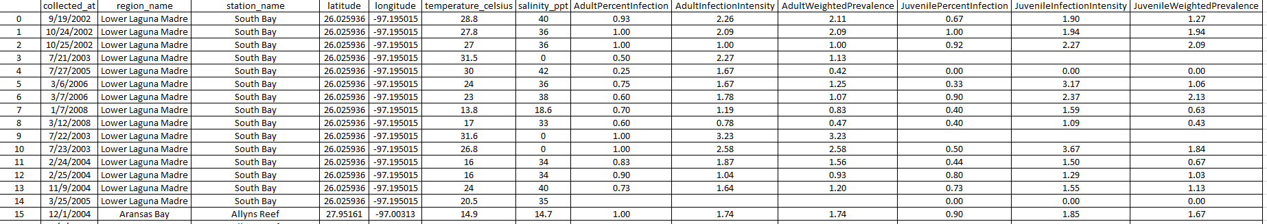
Data Collection
Table 1: Training Features

Slide 8
Data Collection
Table 2: Target Data

Slide 9
Dataset Preprocessing
The data has been preprocessed before applying machine learning algorithms.
  Convert categorical data into one-hot encoding
  Impute the missing values
  Shuffle and normalize the data
  Split the dataset into train and test set

Slide 10
Machine Learning Algorithms
The following Machine Learning Methods are explored:
    Light GBM Regressor (LGB)
    XGBoost Regressor (XGB)
    Support Vector Machine Regressor (SVM)
    Extra Trees Regressor (ETR)
    k-Nearest Neighbor Regressor (kNN)
    Bagging Regressor (BAG)
    Random forest Regressor (RFR)

Slide 11
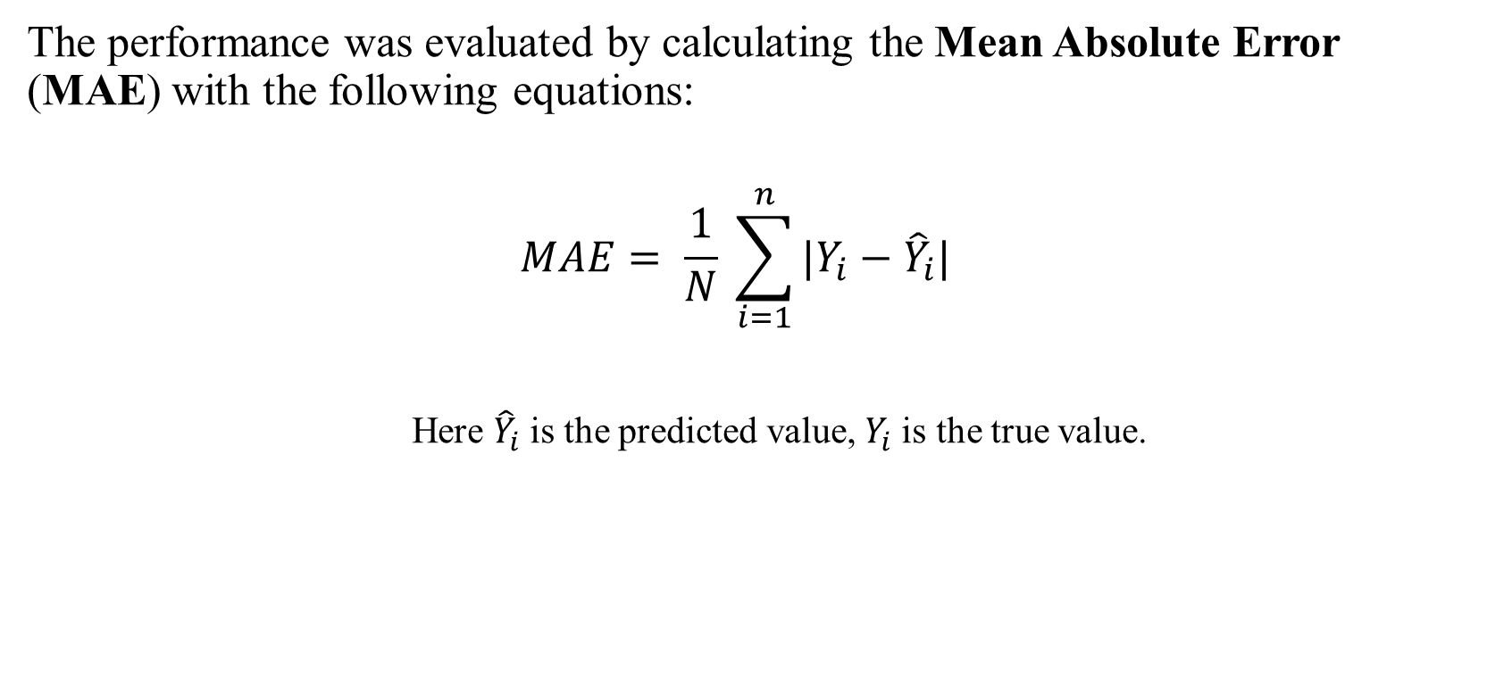
Performance Measures
The performance was evaluated by calculating the Mean Absolute Error (MAE) with the following equations:
  $$MAE= \frac{1}{N} \sum_{i=1}^{n}{|Y_{i}−{\hat{Y}}_{i}|}$$
  Here ${\hat{Y}}_{i}$is the predicted value, $Y_{i}$is the true value.

Slide 12
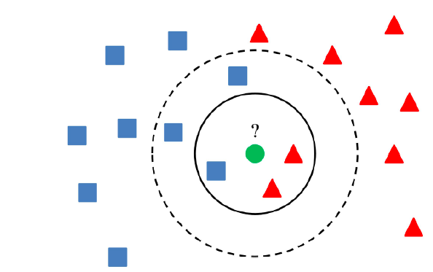
Imputation of Missing Values
  Drop missing values or fill with zeros
  Imputation Using k nearest neighbor (k-NN)
  Imputation Using Mean/Median/Most Frequent Values
  Imputation Using Deep Learning
Figure 2: k nearest neighbor (k-NN)
Image Source: https://vitalflux.com/k-nearest-neighbors-explained-with-python-examples/

Slide 13
Comparison between ML Methods
Table 3: Performance comparison of the machine learning methods based on the test dataset.

Slide 14
Comparison between Imputation Methods
Table 4: Performance comparison of the Imputation methods in terms of Average MAE for the test dataset.

Slide 15
Feature Selection and Hyperparameter Tuning
Feature selection algorithms:
      Genetic Algorithm (GA)
      Incremental Feature Selection (IFS)
Hyperparameter tuning :
      Randomized Parameter Optimization (RPO)
      Exhaustive Grid Search (EGS)
We found that IFS and EGS perform the best with the following hyperparameter for Extra Tree Regressor:
      'n_estimators': 267,
      'max_depth': 15,
      'min_samples_split': 53

Slide 16
Feature Selection and Hyperparameter Tuning
Table 5: Performance comparison of the different features and parameter selection methods in terms of MAE for the test dataset.
GA : Feature Selection with Genetic Algorithm
IFS : Incremental Feature Selection Method
Grid: Exhaustive Grid Search for Parameter Optimization
Random : Randomized Parameter Optimization

Slide 17
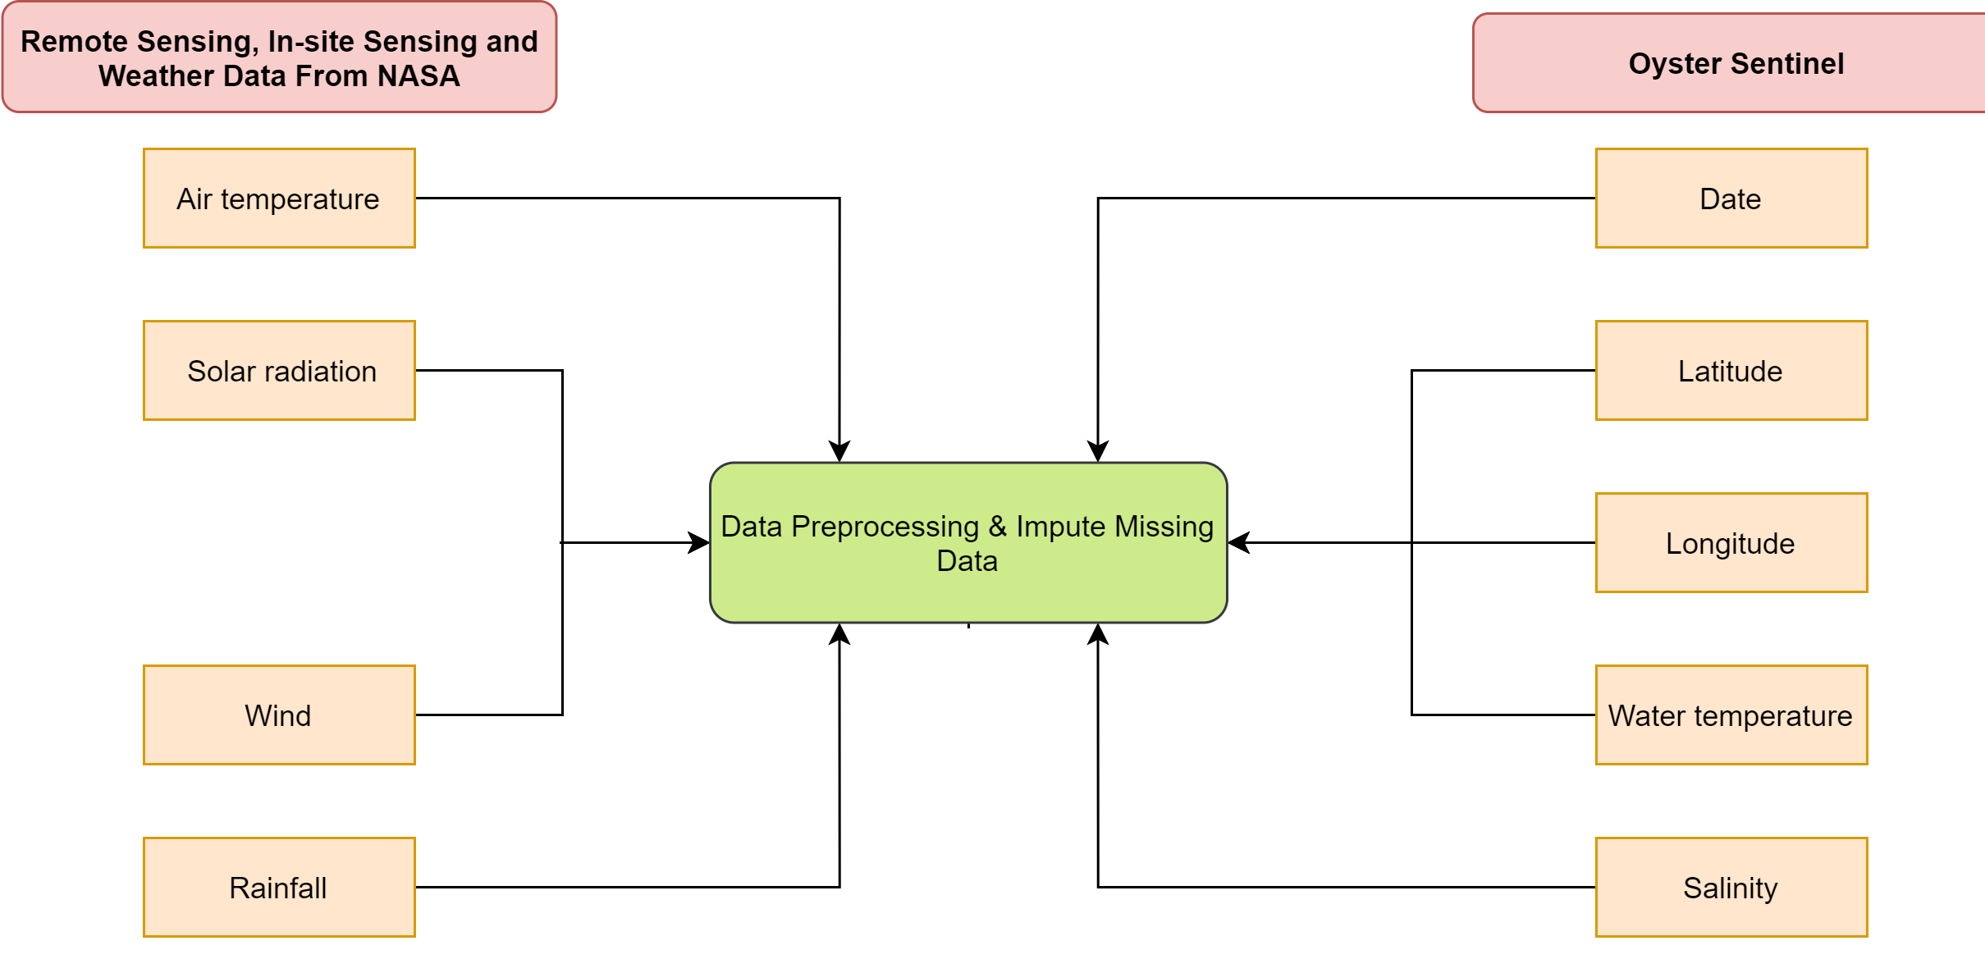
Weather Data from NASA
Figure 3: Weather data as features.

Slide 18
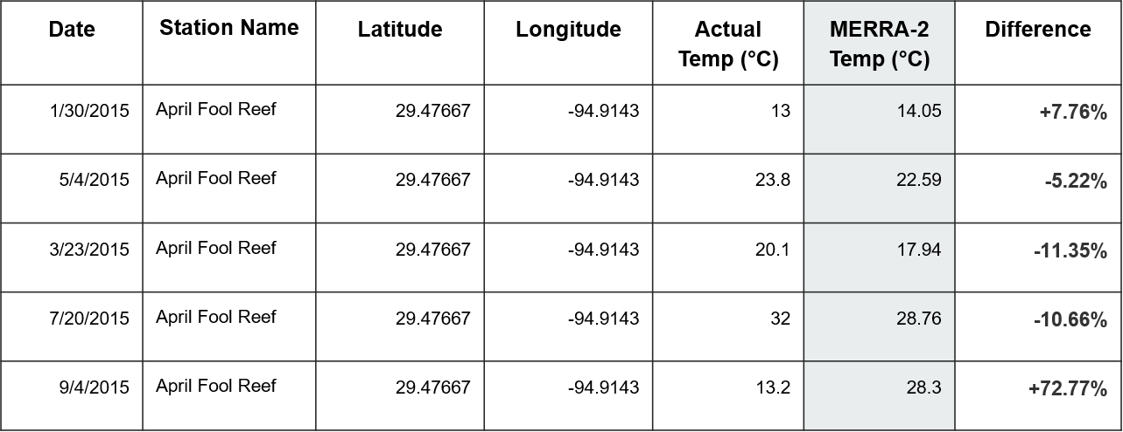
MERRA-2
A reanalysis data product from NASA
  blend of observations with past short-range weather forecasts rerun with modern weather forecasting models and
  provides the most complete picture currently possible of past weather and climate.
The website provides data beginning in 1980 and has a native resolution of 0.5° lat x 0.625° lon
Table 6: Comparison of measured temperature with the temperature obtained from MERRA-2 dataset
link: https://gmao.gsfc.nasa.gov/reanalysis/MERRA-2/

Slide 19
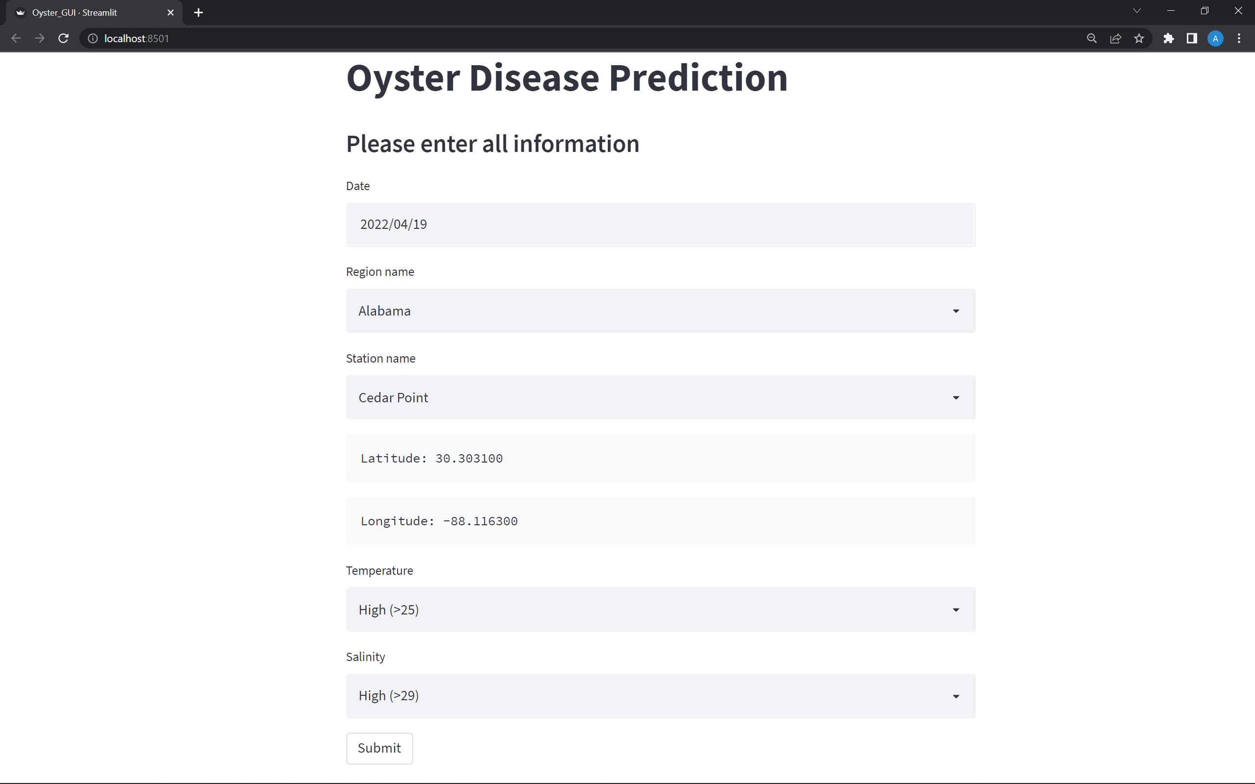
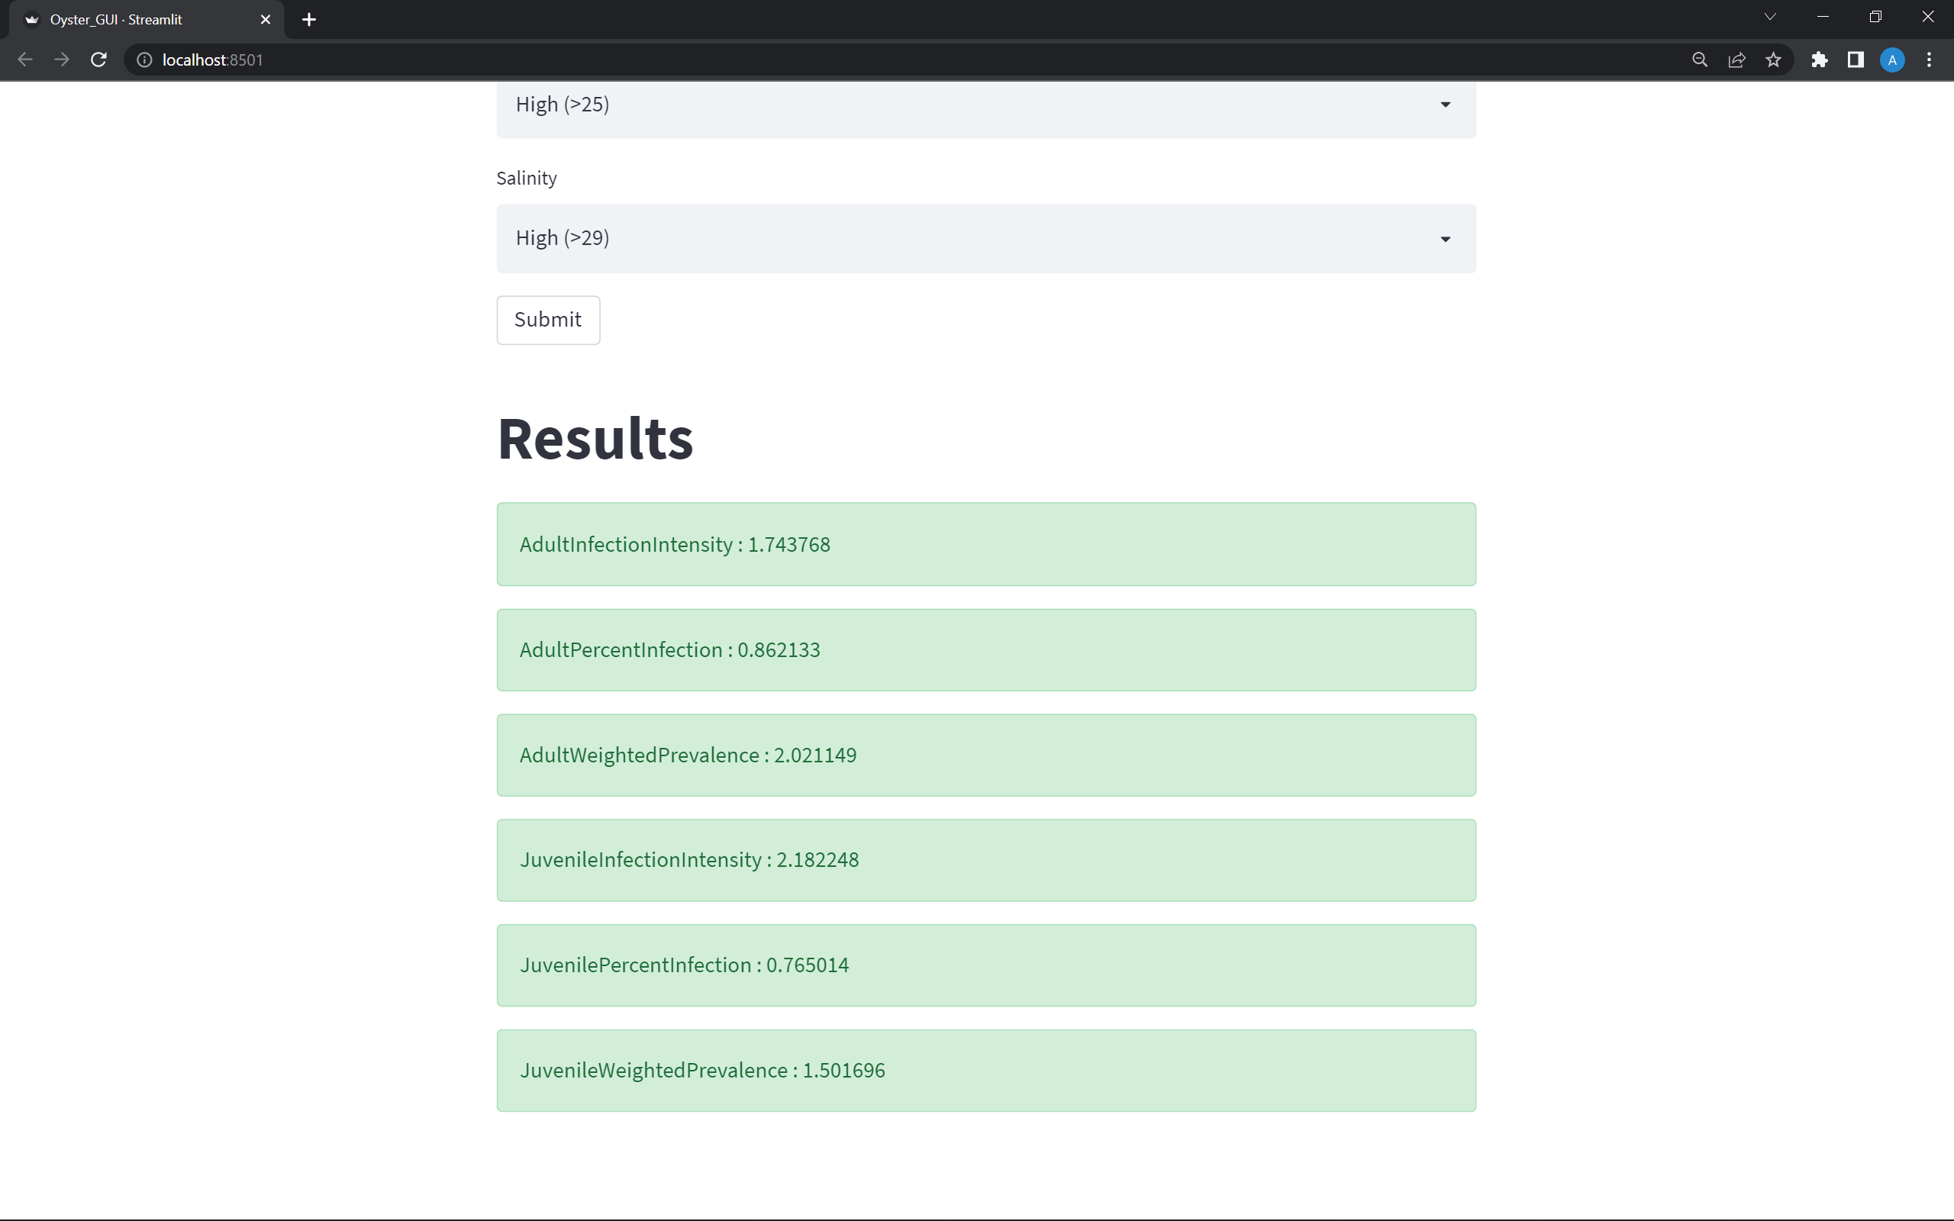
Web Application
Figure 4: Screenshot of the web application

Slide 20
Conclusions and Future Works
The results show that the Extra Tree Regressor performs better based on the MAE metric.
In the future, we plan to incorporate the last 15 days' weather data for each sample from MEERA-2.
We will do an ablation analysis to find which features contribute most to the Oyster disease prediction.
We believe the predictive tools will be helpful to the researchers to prevent future Oyster diseases.

Slide 21
Thank You!
Any Questions?
(mkabir3@uno.edu)

Slide 22

Acknowledgments
We gratefully acknowledge the Louisiana Board of Regents through the Board of Regents Support Fund, LEQSF (2016-19)-RD-B-07

