Slide 1
Effective Prediction of RNA-Binding Proteins Using Machine Learning Techniques
Reecha Khanal
Mentor: Avdesh Mishra
Supervisor: Dr. Md Tamjidul Hoque
University of New Orleans
Department of Computer Science

Slide 2
Presentation Overview
Brief Background
Objective
Dataset Collection
Feature Extraction
Methods
Performance Evaluation
Conclusions

Slide 3
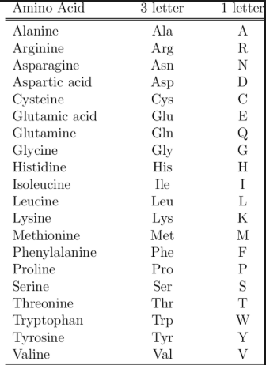
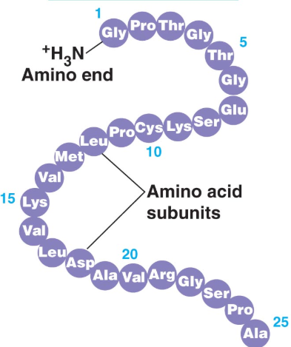
Brief Background
Amino Acids:
Organic Compounds with key elements of carbon(C), hydrogen(H), oxygen(O), and Nitrogen(N)
20 Standard Amino Acids
Proteins:
Sequence of Amino Acids

Slide 4
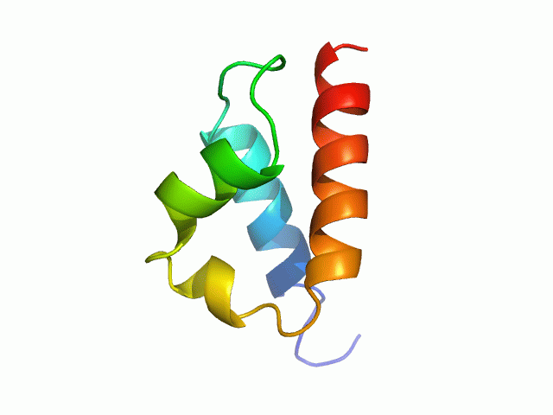
Brief Background
Amino Acids:
Organic Compounds with key elements of carbon(C), hydrogen(H), oxygen(O), and Nitrogen(N)
20 Standard Amino Acids
Proteins:
Sequence of Amino Acids

Slide 5
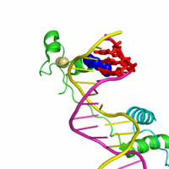
Objective
To develop a computational approach for prediction
of RNA Binding Proteins (RBP) from
Non-RNA Binding Proteins (NRBP).

Slide 6
Why RNA Binding Protein Prediction?
RNA Binding Proteins are important in many biological functions:
mRNA stability
Stress response
Cell cycle
Tumor Differentiation
RNA Binding Proteins have been linked to some critical diseases:
Cancer
Neuro-degenerative diseases
Immunological disorders
Muscular atrophies and
Metabolic disorders

Slide 7
Data Collection
PISCES
UniProt Database
Sequence Identity : 25%
68084 RBPs
X-ray resolution: 3Å
Sequence Length: 50 – 10,000 amino acids
14389
NON-RBP Protein Chains

Slide 8
Data Collection
14389
Protein Chains
68084 RBPs
CD-HIT:
Sequence Identity Cutoff >= 25%
Protein Length: 50 – 10,000 amino acids
7077 NonRBPs
2770 RBPs

Slide 9
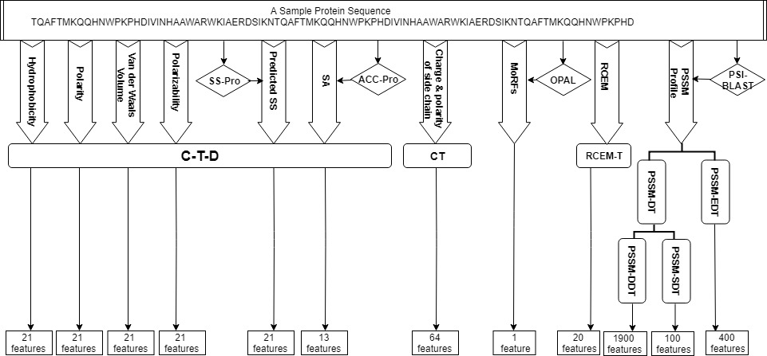
Feature Extraction

Slide 10
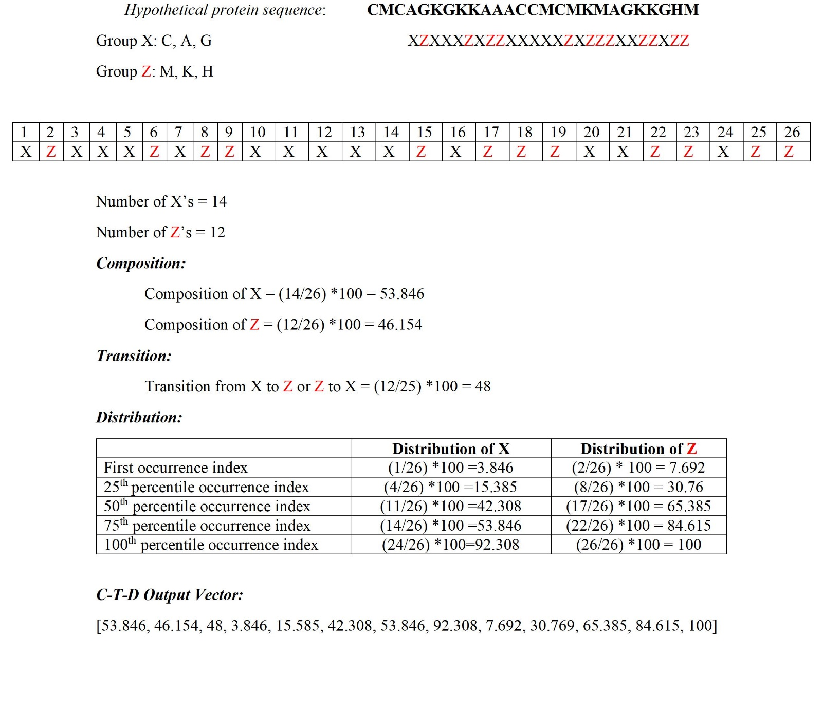
Composition, Transition, and Distribution (C-T-D)

Slide 11
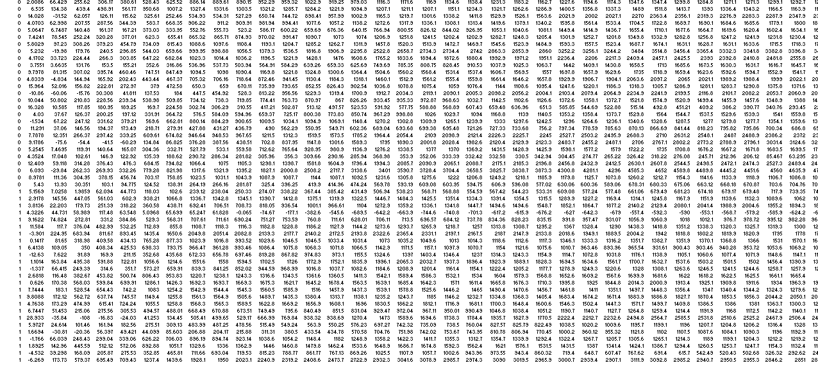
Feature Set
 | 1 | … | 2602 | 2603
0 | 12.496 | … | 0.579 | 97.89
0 | 13.587 | … | 0.6786 | 96.65
. . . | . . . | . . . | . . . | . . .
1 | 8.78678 | … | 0.123123 | 56.87
1 | 7.78927 | … | 0.061447 | 60.761

Slide 12
Feature Selection
Incremental Feature Selection
Removed 21 features
2582 features were selected out of 2603 features
Genetic Algorithm
Removed 1257 features
1346 features were selected out of 2603 features

Slide 13
Machine Learning

Slide 14
Machine Learning Approaches
Comparison of various machine learning algorithms on the benchmark dataset through 10-fold CV.
Metric/ Methods | Bagging | K Nearest Neighbours | Logistic Regression | Random Forest | Extreme Gradient Boosting Classifier (XGBC) | Extremely Randomized Trees (ET)
Sensitivity (%) | 82.18 | 57.54 | 82.00 | 72.24 | 89.09 | 67.44
Specificity (%) | 96.84 | 89.17 | 96.39 | 98.47 | 97.48 | 98.58
Balanced Accuracy (%) | 89.51 | 73.35 | 89.20 | 85.36 | 93.28 | 83.01
Accuracy (%) | 92.68 | 80.19 | 92.31 | 91.03 | 95.10 | 89.75
False Positive Rate | 0.032 | 0.108 | 0.036 | 0.015 | 0.025 | 0.014
False Negative Rate | 0.178 | 0.425 | 0.180 | 0.278 | 0.109 | 0.326
Precision (%) | 91.14 | 67.77 | 90.00 | 94.92 | 93.34 | 94.96
F1-score | 0.866 | 0.622 | 0.858 | 0.820 | 0.912 | 0.789
MCC | 0.816 | 0.492 | 0.807 | 0.775 | 0.878 | 0.742

Slide 15
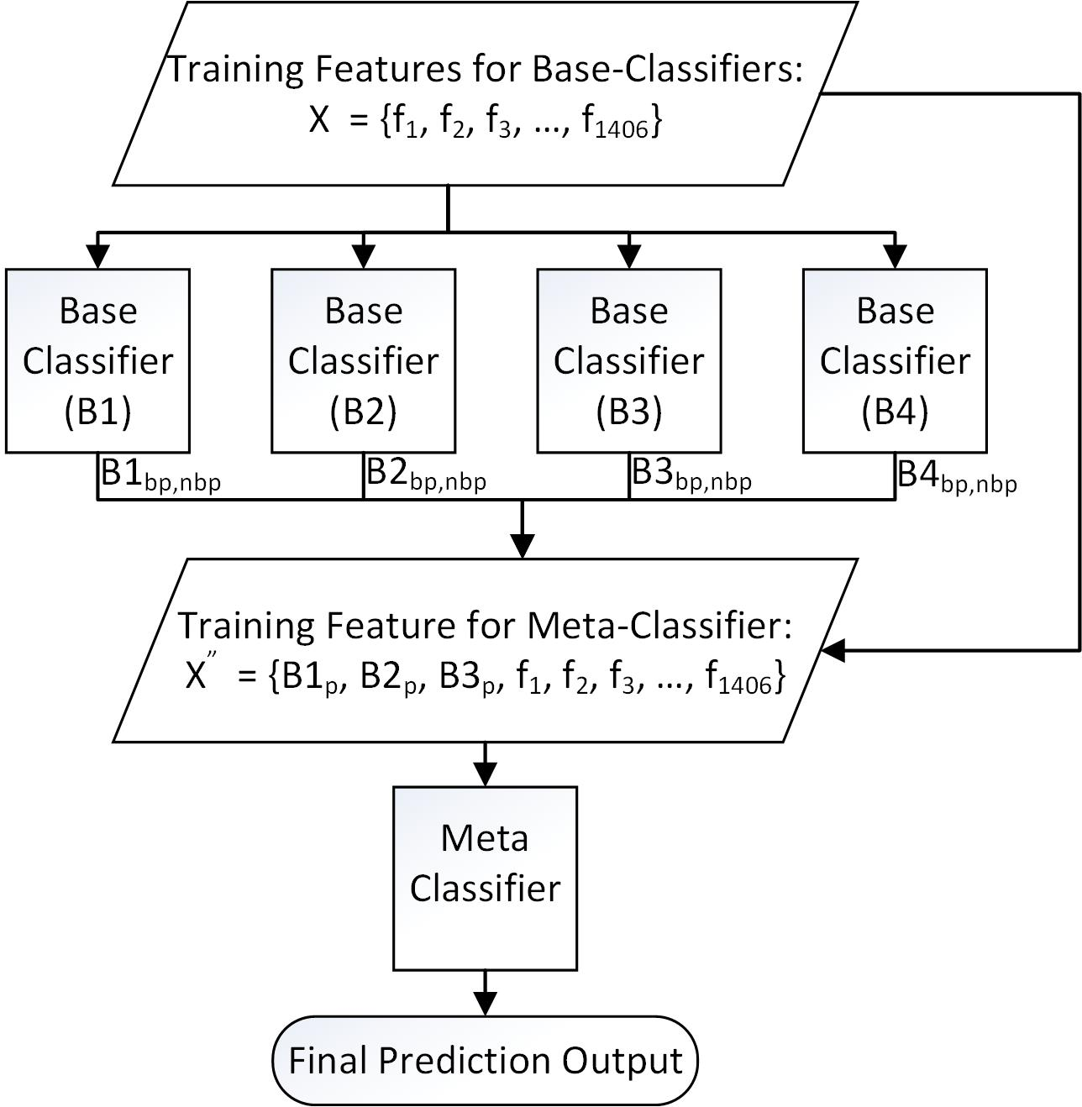
Stacking:

Slide 16
Stacking Models
SM1: RDF, XGBC, LogReg, KNN in base-level and XGBoost in meta-level,
SM2: Bag, XGBC, LogReg, KNN in base-level and XGBoost in meta-level and
SM3: ET, XGBC, LogReg, KNN in base-level and XGBoost in meta-level.

Slide 17
Performance Comparison of Stacked Models
Performance Comparison
Metric/Methods | SM1 | SM2 | SM3
Sensitivity (%) | 90.17 | 89.99 | 90.53
Specificity (%) | 97.44 | 97.15 | 97.29
Balanced Accuracy (%) | 93.80 | 93.57 | 93.91
Overall Accuracy (%) | 95.38 | 95.12 | 95.38
False Positive Rate | 0.026 | 0.028 | 0.027
False Negative Rate | 0.098 | 0.100 | 0.095
Precision (%) | 93.31 | 92.59 | 92.98
F1-score | 0.917 | 0.912 | 0.917
MCC | 0.885 | 0.879 | 0.885

Slide 18
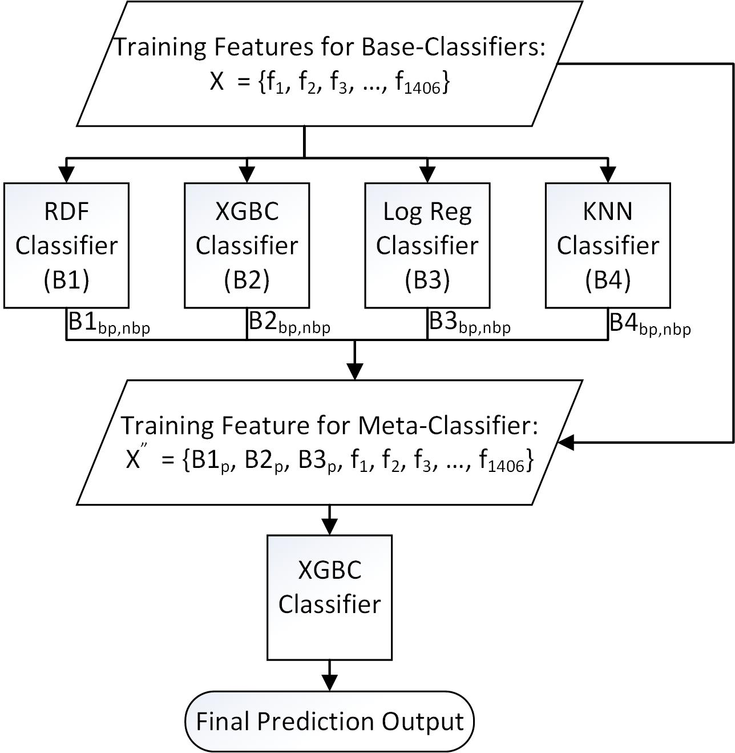
Stacking:

Slide 19
FrameWork:

Slide 20
Performance Comparison
Metric/Methods | RBPPred | AIRBP (% imp.)
Sensitivity (%) | 83.07 | 90.17 (8.55%)
Specificity (%) | 96.00 | 97.44 (1.50%)
Balanced Accuracy(%) | - | 93.80 (-)
Overall Accuracy (%) | 92.36 | 95.38 (3.26%)
False Positive Rate | - | 0.026 (-)
False Negative Rate | - | 0.098 (-)
Precision (%) | 89.00 | 93.31 (4.84%)
F1-score | 0.859 | 0.917 (6.75%)
MCC | 0.808 | 0.885 (9.53%)

Slide 21
Performance Comparison on Test Dataset
Methods | Dataset | Evaluation Metrics
 |  | Sensitivity (%) | Specificity (%) | Balanced Accuracy (%) | Overall Accuracy (%) | FPR | FNR | Precision (%) | F1-score | MCC
RBPPred | Human | 84.28 | 96.65 | - | 89.00 | - | - | 97.65 | 0.905 | 0.788
 | S. cerevisiae | 86.16 | 94.59 | - | 87.73 | - | - | 96.52 | 0.910 | 0.729
 | A. thaliana | 86.40 | 94.59 | - | 87.02 | - | - | 94.59 | 0.925 | 0.537
AIRBP | Human (% imp.) | 92.14 (9.32%) | 94.52 (-2.21%) | 93.33 (-) | 93.04 (4.54%) | 0.055 (-) | 0.079 (-) | 96.53 (-1.14%) | 0.943 (4.19%) | 0.855 (8.50%)
 | S. cerevisiae (% imp.) | 94.35 (9.51%) | 84.33 (-10.85%) | 89.34 (-) | 91.60 (4.41%) | 0.157 (-) | 0.057 (-) | 94.09 (-2.52%) | 0.942 (3.52%) | 0.789 (8.23%)
 | A. thaliana (% imp.) | 92.11 (6.61%) | 86.11 (-8.97%) | 89.11 (-) | 91.67 (5.34%) | 0.139 (-) | 0.079 (-) | 98.82 (4.28%) | 0.953 (3.03%) | 0.594 (10.61%)
 | (avg. % imp.) | (8.48%) | (-7.34%) | (-) | (4.76) | (-) | (-) | (0.21%) | (3.58%) | (9.11%)

