Slide 1
Detection of Sand Boils using Machine Learning Approaches
Presented by Aditi Kuchi
Supervisor: Dr. Md Tamjidul Hoque

Slide 2
Presentation Overview
Sand boils – What, How, Why +Motivation
Dataset
Methods used & explanations, discussion
Viola-Jones’ algorithm (Haar cascade)
You Only Look Once (YOLO)
Single Shot MultiBox Detector (SSD)
Non – deep learning methods (SVM, GBC, KNN, etc.)
Stacking
Results
Conclusions

Slide 3
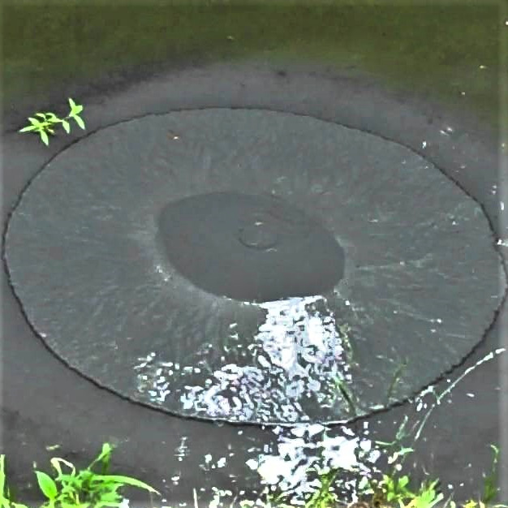
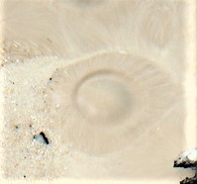
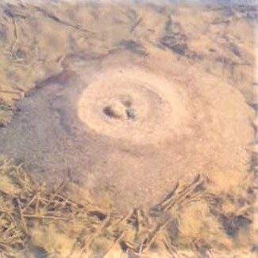
Sand Boil
Sand Boil?
Levee : An embankment that protects low-lying areas from flooding.
Levees degrade – cracks, impact of severe weather, sand boils.
Sand boils are literal boils of sand on the surface.
Sand boil occurs on the land side of levee.

Slide 4
Sand Boil - Formation
Levee
Sand Boil and Leakage
Water
Silt/Clay Blanket
Concentrated Flow
Sand foundation

Slide 5
Sand Boil – Important!
Studying sand boils – why?
Sand boils are a threat to levee health.
Contribute to failure of levees.
Leads to flooding, property damage, loss of life.
Example of levee failure: Katrina, 2005.
Factors influencing formation:
Presence of pot-holes, cracks, fissures, repeated drying of soil (causes cracks), uprooted trees, decaying roots, underground animal activity.

Slide 6
This Research
Sand boils cause levee failure = destruction.
50 failures of flood walls in New Orleans during Katrina. Caused flooding in 80% of New Orleans’ areas.
Monitoring of levees is very important.
Monitoring levees is currently done manually.
Aim: Automate this process using object detection machine learning approaches to help personnel be more targeted in their monitoring.
First research work using ML for sand boil detection.

Slide 7
This Research
Object detection – detects positive instances of a target object.
Good subject for object detection – Sand boils have very characteristic features – circular, darker center, etc.
Uses computer vision and Machine Learning to detect sand boils.
When we supply the models with a positive image, it can classify whether it has a sand boil or not.
If it has a sand boil, it draws a bounding box around it.

Slide 8
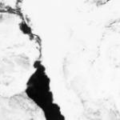
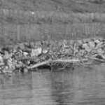
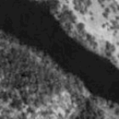
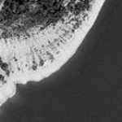
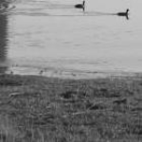
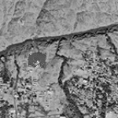
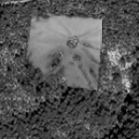
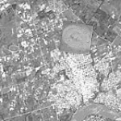
Datasets

Slide 9
Collection of Data
No easily available data for sand boils.
Collected data on our own
ImageNet – dams, levees, water-related images
Google Images – “levees”
OpenStreetMap –
Does not have labels (unlike Google Maps)
Zoom in near Mississippi river – collect image
Slice into 150x150 (Bash script + ImageMagick)

Slide 10
Collected Data
Two types
Positive images – have a sand boil in them.
Negative images – must not have any positive sample in them.
Collected negatives – 6300 + images
Collected positives – 20 images from Google Images.
Resized to 50x50.
To create more samples – positives are superimposed onto selected set of negative images.
Rotated, resized by OpenCV.

Slide 11
Creation of datasets
Viola Jones
Train – 3000 Neg, 4500 Pos
Test – 2000 Neg, 6300 Pos
YOLO
Train – Annotated 956 Pos, 956 Neg
Test – Annotated 239 Pos, 239 Neg
SSD
Train – Annotated 956 Pos, 956 Neg
Test – Annotated 239 Pos, 239 Neg
Others (SVM, GBC, etc.
Train – 956 Pos, 956 Neg, Combined feature file
10-fold Cross Validation

Slide 12
Methods
Viola Jones Object Detector
You Only Look once Object Detector
Single Shot MultiBox Detector
Non-Deep Learning Methods
2001 method
Popular
Very fast
Less computational load than others
New method
Popular
Requires LOT of samples
High computational load needed
Latest method (2019 paper)
Requires LOT of samples
High computational load needed
Popular
Stackable
Tried & tested
Deep Learning

Slide 13
Viola-Jones Object Detector
1. Feature Generation or Extraction
2. Calculation of integral image
3. Boosting using AdaBoost algorithm
4. Cascading – rejecting negatives fast + keeps potential positives
Use OpenCV (Open Source Computer Vision Library)
Is an open source computer vision and machine learning software library.
Has many functions & supports Python, C++, Java, MATLAB.

Slide 14
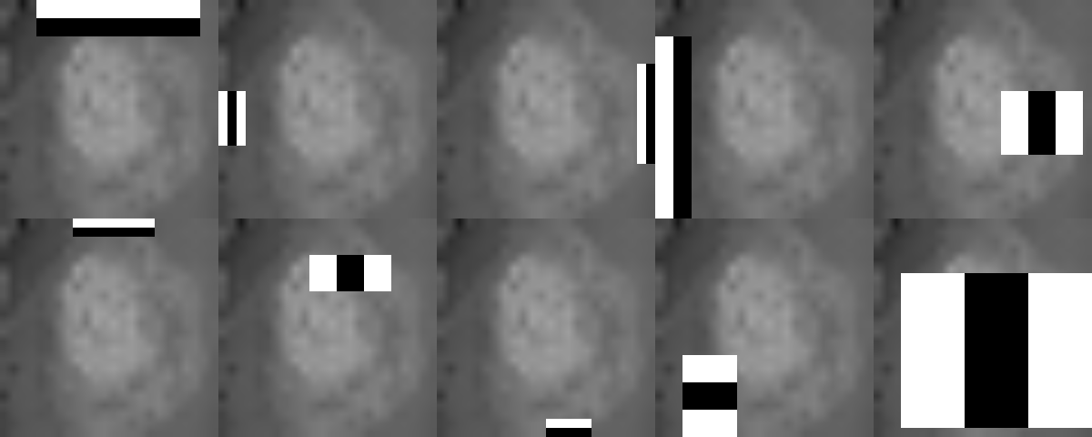
Feature Extraction
Using Haar-like features.
They are rectangular images in black and white that can capture certain characteristics of each image.
Notes:
Sub-windows w × h are run over the whole image scanning for features.

Slide 15
Integral Image
Integral image is the summation of pixels from the top left of the pixel under consideration.
1 | 2 | 3 | 3
2 | 3 | 4 | 4
5 | 2 | 3 | 1
5 | 2 | 4 | 3
1 | 3 | 6 | 9
3 | 8 | 15 | 22
8 | 15 | 25 | 33
13 | 22 | 36 | 47

Slide 16
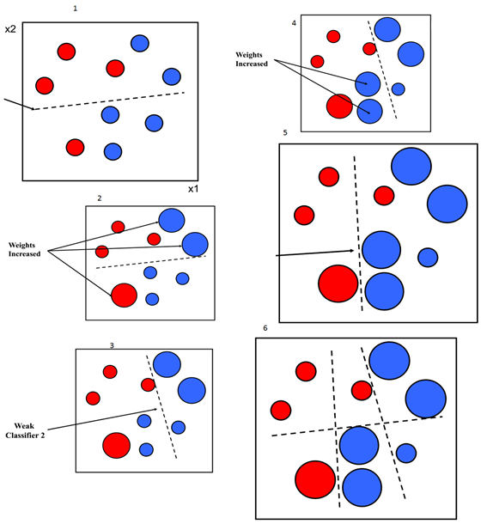
AdaBoost
AdaBoost is an ML algorithm that adaptively increases the weights of the weak learners to create better decision boundaries.
Viola Jones algorithm uses AdaBoost to weed out non-helpful Haar features.

Slide 17
Haar Cascade
Layer 1
Layer 2
Layer 3
…
Layer n
All Sub-Windows
True
True
True
True
False
False
False
False
Pool of Rejected Sub-Windows

Slide 18
Viola-Jones’ Results
Runs for 25 stages. Performance is tested at 10, 15, 20 and 25.
Stage 15 performs the best.
The output images are divided into 4 categories – TP, TN, FP, FN.
Based on these, Accuracy is calculated, and bounding boxes are drawn.
Accuracy is 87.22%.

Slide 19
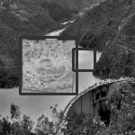
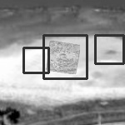
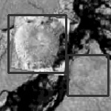
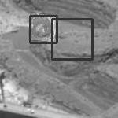
Viola-Jones – Results & Discussion on False Positives
False positives fall within reasonable doubt of being a sand boil.
If these are classified as True Positive, the accuracy rates would be much higher.

Slide 20
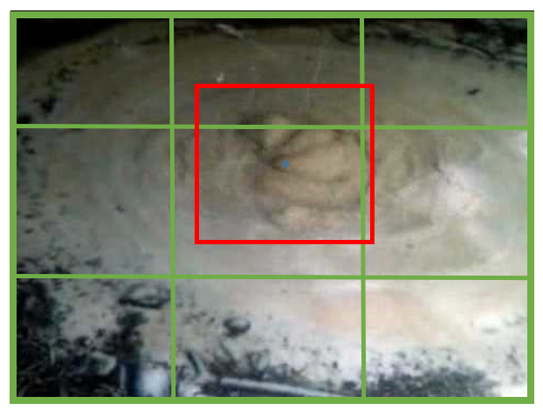
You Only Look Once (YOLO) Detection
One of the new and popular approaches using deep learning.
Input image is divided into S × S grid of cells.
For each image, if the center falls into a cell of the grid, it is responsible for prediction.
Output prediction is of form (x, y, w, h, confidence)

Slide 21
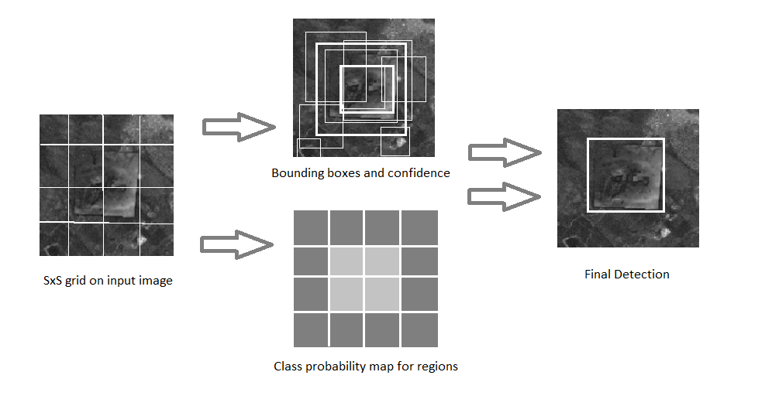
YOLO Detection
YOLO is RPN based
Bounding box predictions + confidence scores + class probabilities = Final detection.

Slide 22
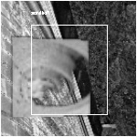
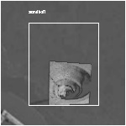
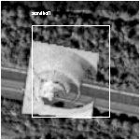
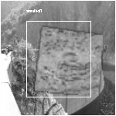
YOLO Detector - Results
Used a Tensorflow Implementation of Darknet (Open source) called Darkflow.
Hand annotated 1195 images containing sand boils.
Used an 80-20 split for training and testing.
Tuned the configuration of the net to get good results.
Ran for more than 2000 epochs.

Slide 23
Single Shot MultiBox Detector (SSD)
Single Shot MultiBox Detector is also a deep learning method – 2019, one of the latest.
Take only a single pass over the image to detect multiple objects.
SSD is very fast.
This SSD model builds on MobileNetV2 which acts as a feature extractor in the initial stages.
Notes:
YOLO goes twice – generate Bboxs, region proposals.

Slide 24
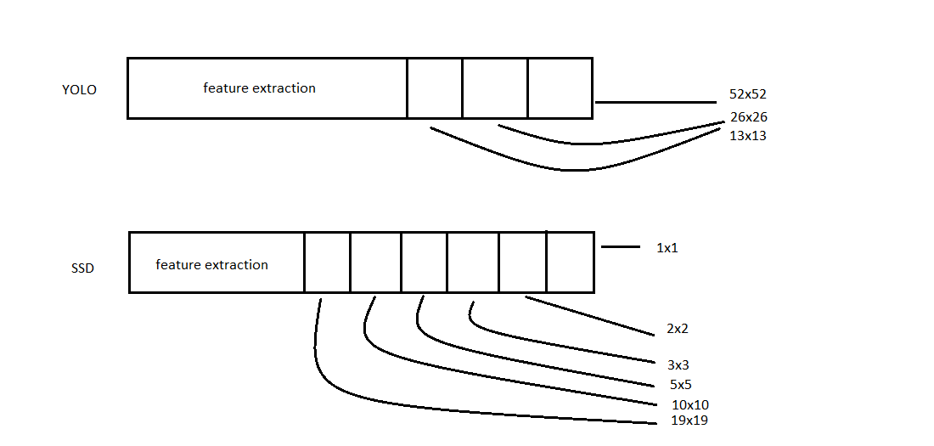
SSD
We use a PyTorch implementation of SSD.
Some parameters are tuned from the original.
Trained for 200 epochs.
Latest generated checkpoint is used to predict the bounding boxes.
Difference between YOLO and SSD

Slide 25
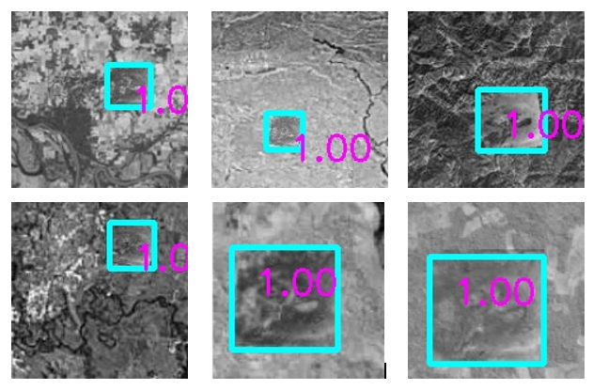
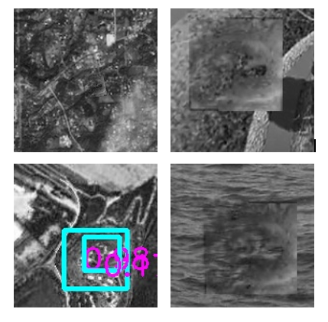
SSD – Results & Discussion on Hard False Negatives, etc.
Accuracy: 88.35%
Difficult to classify- Different textures in the terrain..
2 bounding boxes – with different confidence scores.

Slide 26
Machine Learning Methods
Support Vector Machine (SVM)
K Nearest Neighbors (KNN)
Gradient Boosting (GBC)
eXtreme Gradient Boosting (XGBC)
Extra Tree (ET)
Random Decision Forest (RDF)
Logistic Regression (LogReg)
Bagging

Slide 27
Feature Extraction
Features need to be manually extracted for these methods unlike the previous three.
Chose a total of 4 features.
Hu Moments
Haralick Features
Histogram
Histogram of Oriented Gradients (HOG)

Slide 28
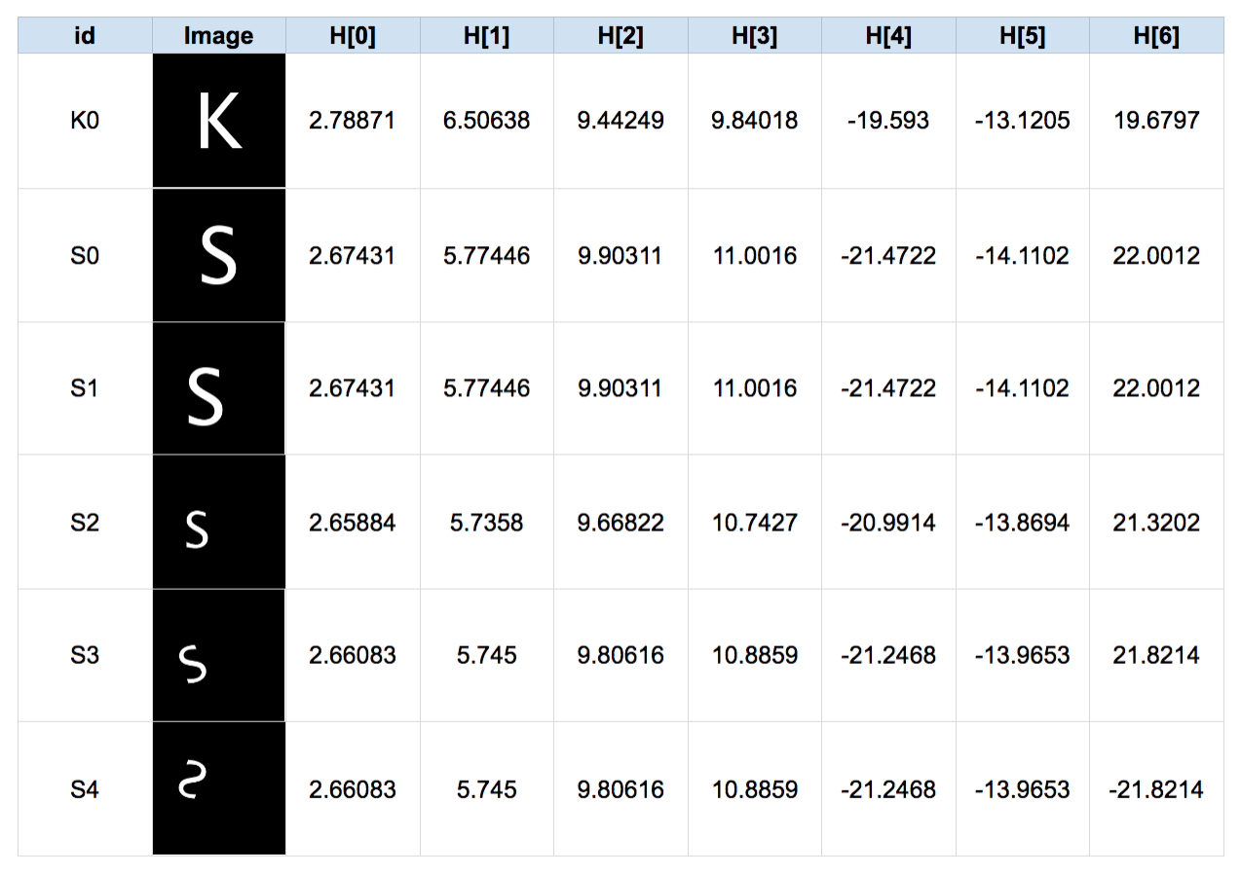
Hu Moments
They are a list of 7 features.
Weighted average of image pixel intensities.
Reads in grayscale → Binarize it using a threshold → calculation of moments → log transform (optional)

Slide 29
Haralick Features
Used for texture analysis – 13 features
It is the number of grey levels in the image.
Counts the number of times a pixel with value i is adjacent to a pixel of value j. Divide the entire matrix by the total number of comparisons made.
Each entry is the probability of finding i next to j.
Rotation invariant feature.
Works for sand boils because circular, textured, have similarities.

Slide 30
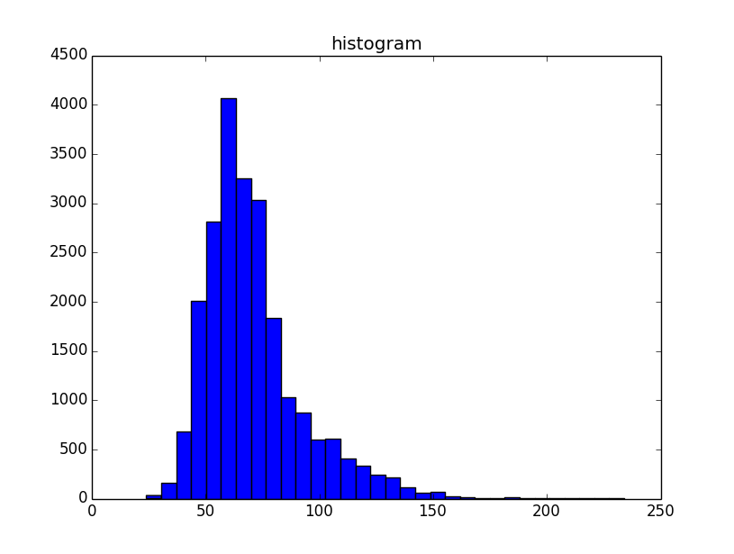
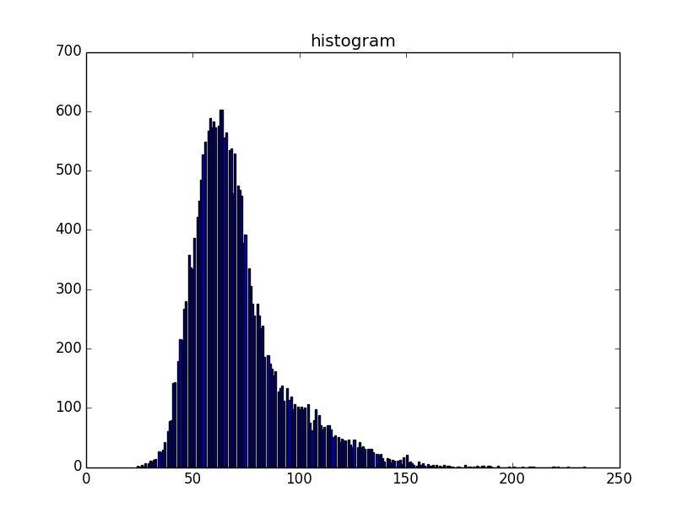
Histogram
Is a graph plot representing distribution of pixel intensities.
32 bins are enough to represent a 150×150 image instead of 256.
Provides 32 features.

Slide 31
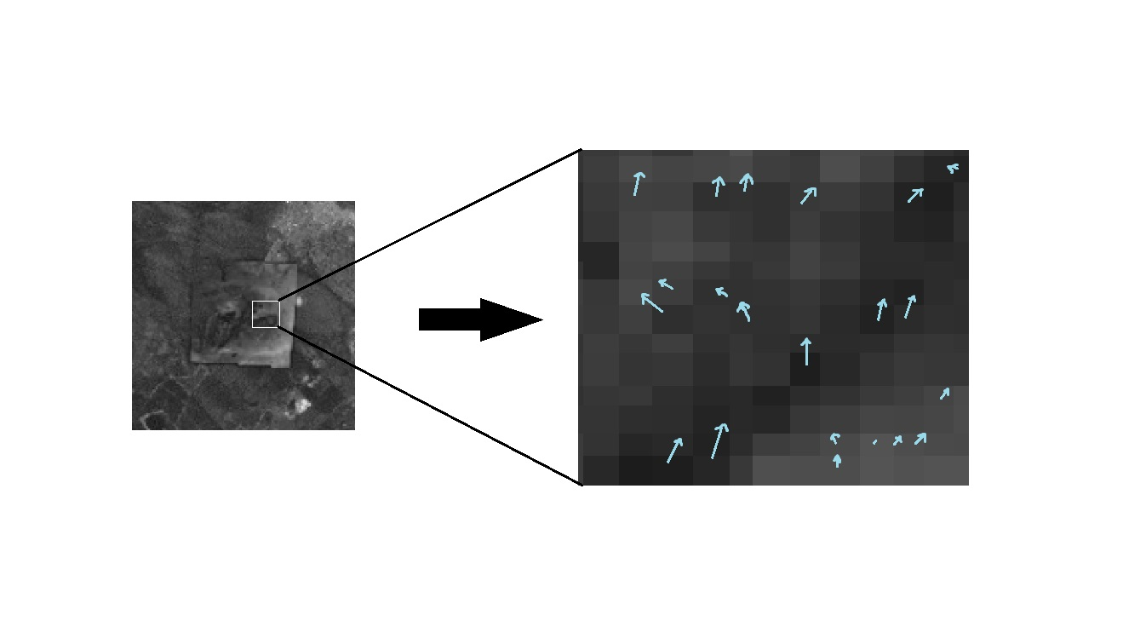
Histogram of Oriented Gradients
Counts the occurrences of edge orientations in an image.
Scale invariant feature.
Divided into small cells
Provides 648 features.

Slide 32
Results of Different Methods
Method | Sensitivity | Specificity | Accuracy | Precision | F1 Score | MCC
SVM | 97.49 | 92.05 | 94.77 | 92.46 | 0.949 | 0.8967
KNN | 61.82 | 81.9 | 71.86 | 77.35 | 0.6872 | 0.4463
GBC | 97.28 | 88.49 | 92.88 | 89.42 | 0.9318 | 0.8610
XGBC | 89.43 | 89.33 | 89.38 | 89.34 | 0.8938 | 0.7876
RDF | 92.46 | 89.74 | 91.11 | 90.02 | 0.9122 | 0.8224
ET | 95.5 | 90.48 | 92.99 | 90.93 | 0.9316 | 0.8609
LOGREG | 81.27 | 81.79 | 81.53 | 81.7 | 0.8148 | 0.6307
BAGGING | 92.05 | 87.34 | 89.69 | 87.91 | 0.8993 | 0.7958

Slide 33
Feature Selection
Used Genetic algorithm on the 700-feature file.
324 features were selected.
Results - lower than full dataset (for all methods).
Possible reasons – GA used XGBC for fitness computation.
HOG – Information from neighboring pixels.
Notes:
A whole group of features might be contributing to the performance of the model. For example, HOG.

Slide 34
Stacking
Images
700 Input Features
Moments, Haralick, HOG…
ETC
Classifier
KNN
Classifier
LogReg
Classifier
SVM
Classifier
Base Classifiers for Stacking
Input features + Predicted probabilities from the Base Classifiers
Feature array after adding the probabilities for base classifiers
SVM
Classifier
Meta Classifier for Stacking
Prediction of sand boil
Predicted Output

Slide 35
Stacking Results
Model type and Description | Sensitivity | Specificity | Accuracy | Precision | F1 Score | MCC
RDF LogReg KNN | 0.9749 | 0.91527 | 0.94508 | 0.92004 | 0.94667 | 0.89175
LogReg ET KNN | 0.98117 | 0.9205 | 0.95084 | 0.92505 | 0.95228 | 0.90334
LogReg SVM ET KNN | 0.97803 | 0.92992 | 0.95397 | 0.93313 | 0.95506 | 0.909
LogReg GBC SVM | 0.96757 | 0.94038 | 0.95397 | 0.94196 | 0.95459 | 0.90829
RDF KNN Bag | 0.95816 | 0.90586 | 0.93201 | 0.91054 | 0.93374 | 0.8652
LogReg SVM ET KNN | 0.96444 | 0.9341 | 0.94927 | 0.93604 | 0.95003 | 0.89895
Meta as SVM
Meta as GBC

Slide 36
Final Results – A Comparison
Model Name | Accuracy
Viola Jones Object Detector | 87.22%
Single Shot MultiBox Detector | 88.35%
Other Methods (Selected SVM best) | 94.77%
Stacking (LogReg, SVM, ET, KNN) | 95.39%

Slide 37
Conclusions
We tested renowned and modern object detection algorithms to find the ones that work best for detecting sand boils.
We find that our stacking method performs the best (95.4%)
Further research: Better implementation of YOLO, collection of real-world images of sand boils, stacking deep learners with non-deep learners.

Slide 38
Thank you!
Questions?

