Slide 1
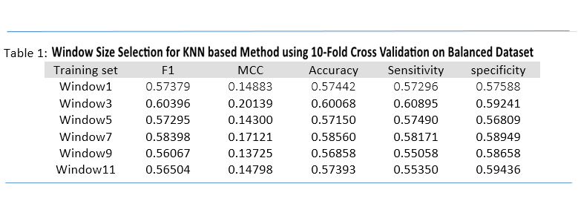
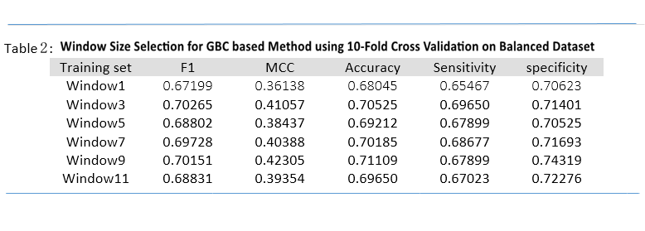
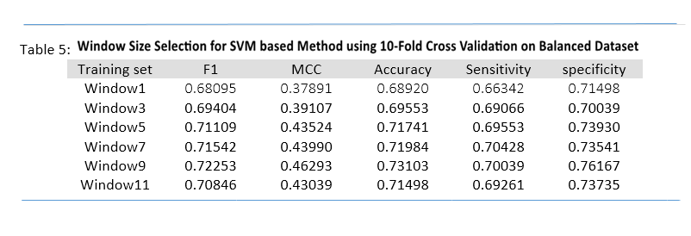
Sequence-Based Prediction of Protein Carbohydrate Binding Sites Using Machine Learning Techniques Lijing Cui§, Avdesh Mishra§, Joel Andrepont, Md Tamjidul Hoque* §These authors contributed equally to this work. *Corresponding author. email: {lcui,amishra2, jaandrep, thoque}@uno.edu Department of Computer Science, University of New Orleans, New Orleans, LA, USA
Introduction
Results
Discussions
Protein-Carbohydrate binding plays an important role in many biological processes such as:
cellular adhesion
host-pathogen recognition
inferences to drug targeting and
gene expression
Various experimental as well as computational techniques exist, such as
metal nanoparticle probing
molecular docking and
site mapping
However, these techniques require known complex structures which are costly as well as labor intensive to obtain.
We present a sequence-based method to accurately predict protein-carbohydrate binding sites using a effective machine-learning approach.
To accurately predict protein-carbohydrate binding sites, we explored several important sequence and predicted structural features such as:
evolutionary feature called sequence specific scoring matrix (PSSM), protein disorder region, torsion angle flexibility, half sphere exposure, position specific estimated energy and so on.
Feature selection was used to identify the features that significantly influence the accuracy of the proposed predictor.
The results obtained from validation and test, demonstrate robustness of proposed predictor in protein-carbohydrate binding site predictions.
From Table 1 it is evident that KNN attains highest accuracy of 60.06% for window size 3. Similarly, from Table 2 it is evident that GBC attains highest accuracy of 69.65% for window size 3.
From Table 3 it is evident that LogReg attains highest accuracy of 69.26% for window size 5. Similarly, from Table 4 it is evident that RDF attains highest accuracy of 70.03% for window size 3. Likewise, from Table 5 it is evident that SVM attains highest accuracy of 73.1% for window size 9.
Sequence based prediction is useful in protein-carbohydrate binding site prediction and plays significant role in:
Many diseases including cancer.
We explore several important sequence and structure based features such as:
ASA, PSSM
Phi and Psi angels
HSE_up and HSE_down
Physicochemical Properties
10-fold Cross-validation is used to validate the performance of different machine learning methods.
Windowing is applied to include the local (or neighboring residues) features.
Undersampling technique is applied to balance the number of binding and non-binding residues.
Comparative study of five machine learning methods is performed which are listed below:
KNN
Logistic Regression
Gradient Boosting Classifier
Random Decision Forest
Support Vector Machine
SVM showed the best performance among all the methods explored.
Recall/Sensitivity = 0.70039
Specificity = 0.76167
Accuracy Balanced = 0.73103
Overall Accuracy = 0.73103
FPR = 0.23833
FNR = 0.29961
Precision = 0.74611
F1 = 0.72253
MCC = 0.46293
Figure 3: Comparison between different machine learning methods based on accuracy and sensitivity for different window size.
Figure 4: Performance of top performing method, SVM, for different window sizes.
Figure 5: Comparison between SVM and RF Machine Learning Methods based on accuracy and sensitivity for different window sizes.
Accuracy
Methods
Sensitivity
Datasets: We collected a dataset of protein−carbohydrate complexes which consist of 100 protein sequences established previously by Taherzadeh et al. We used these dataset for 10-fold cross-validation of our methods.
Input Features: We used Spider3.0 and Dispredict_V2.0 to generate predicted sequence and structural features such as:
Phi and Psi angles
Half Surface Exposure (Hse_alpha_up and Hse_alpha_down )
Physicochemical Properties (polarity, hydrophobicity, steric parameters etc.)
Sequence Information: Each amino acid residue is represented by 1 for its residue type in a 20-dimensional vector (0 for all other rows).
Evolutionary Information: position specific scoring matrix profile collected from PSIBLAST
Information Entropy: $S_{E}=\sum_{j=1}^{20}{P_{i,j }∗\ln{P_{i,j}}}$
Close Neighbor Correlation Coefficient (CNCC):
$${CNCC}_{ik}=\frac{\sum_{j=1}^{20}{P_{i,j}{ P}_{kj}}}{\sqrt{\sum_{1}^{20}{{P_{ij}}^{2} }\sum_{1}^{20}{{P_{kj}}^{2}}}}$$
Undersampling to balance the data set was performed by randomly selecting a portion of nonbinding residues, so that its number is the same as the number of binding sites for each protein.
The balanced data set with the ratio of 1:1 contains 1028 binding and 1028 nonbinding residues.
Cross-validation: We performed 10-fold cross-validation over the balanced dataset to evaluate our approach. In each round nine folds were employed for training and one fold as test.
Feature windowing is applied to include the neighboring residue features.
Performance Evaluation Criteria: The performance of the proposed method is assessed by following evaluation measures:
Various machine learning methods such as K-nearest neighbor (KNN), Gradient Boosting Classifier (GBC), Logistic Regression (LogReg), Random Decision Forest (RDF/RF) and Support Vector Machine (SVM) are explored in this study.
Table 6: Performance comparison between top performing, SVM based method and second best, RF based method.
Conclusions
 | SVM-accuracy | SVM-sensitivity | RF-accuracy | RF-sensitivity
window1 | 0.6892 | 0.66342 | 0.69115 | 0.67023
window3 | 0.69553 | 0.69066 | 0.71547 | 0.70039
window5 | 0.71741 | 0.69553 | 0.71449 | 0.69358
window7 | 0.71984 | 0.70428 | 0.71206 | 0.68969
window9 | 0.73103 | 0.70039 | 0.72033 | 0.6965
window11 | 0.71498 | 0.69261 | 0.70671 | 0.68288
We propose an accurate sequence-based predictor which combines useful features such as:
Sequence based accessibility
ASA,PSSM
Phi and Psi angels
HSE_up and HSE_down
Physicochemical Properties
Windowing technique was found to be very useful in improving the accuracy of the classifier.
Optimized SVM based machine learning method was found to attain highest accuracy of 73.1%.
Figure 6: Comparison of different machine learning methods based on highest accuracy achieved from best window sizes.
Evaluation Criteria | Definition
Sensitivity | $$\frac{TP}{TP+FN}$$
Specificity | $$\frac{TN}{TN+FP}$$
Accuracy | $$\frac{TP+TN}{FP+FP+TN+FN}$$
Acknowledgements
We gratefully acknowledge the Louisiana Board of
Regents through the Board of Regents Support Fund, LEQSF
(2016-19)-RD-B-07

